Slide 1
Mechanics and machines, Lecture 1
Introduction Engineering Drawing

Slide 2
General information and course outline

Slide 3

Lecturers/Instructors
Oleg Bulichev
University Innopolis
o.bulichev@innopolis.ru
@Lupasic

Slide 4
Course goal
To understand engineers: their problems and their terminology
by doing their job using their tools

Slide 5
Course purpose and objectives
The development of any class of robots and the use of robots in industry requires the engineer to have knowledge and skills in:
- the ability to read engineering drawings,
- the analysis and synthesis of mechanisms,
- the dynamic calculation of mechanisms and machines,
- the calculation of strength and rigidity,
- the technological production processes,
- the work in modern CAD and CAE systems.

Slide 6
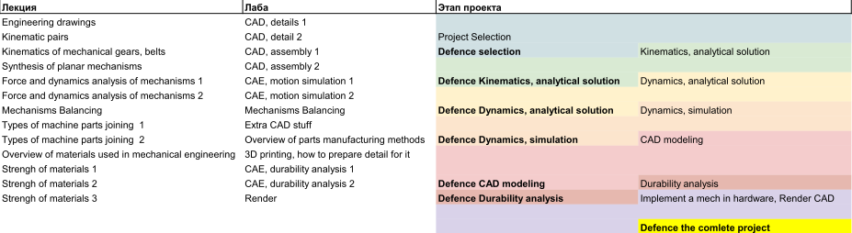
Course outline and organization

Slide 7
Grading criteria
Criteria:
Research project: 40%.
Homework assignments: 30%
Final Exam: 30%
Late policy: -50% of max grade
The scale:
A: 85.00-100%
B: 65.00-84.99%
C: 50.00-64.99%
Failed: 0-49.99% or less than 50% by any criterion, Project should be implemented in hardware

Slide 8
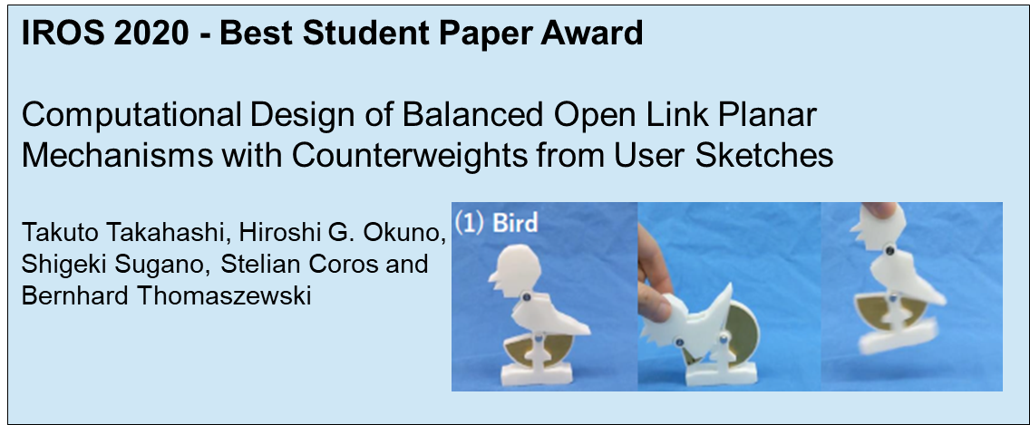
Research Project
The project covers the main stages of the development of the mechanism: idea, synthesis and analysis of kinematics, analysis of dynamics, design, manufacture, verification
Project gives you 40%
Project defense will be organized as a conference at the end of the course
Ideal project = results can be presented at international conferences or published in international journals

Slide 9
Information about project
In another slides

Slide 10
Engineering drawings

Slide 11

Projections
We work with 3D-objects which must be shown in a flat drawing. This is a problem.

Slide 12
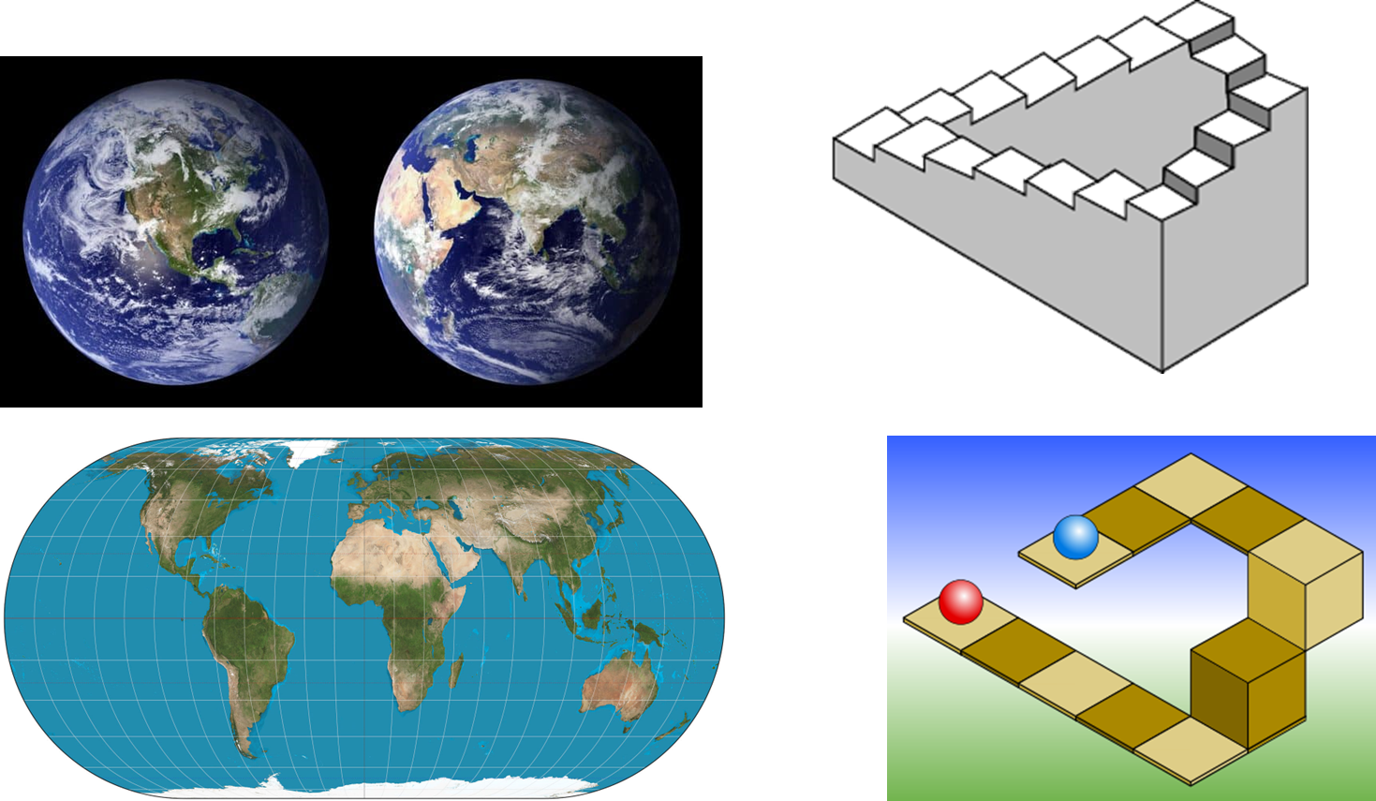
Projections
On the one hand, we cannot accurately show curved surfaces.
On the other hand, we can draw something absolutely impossible or something possible but unclear.

Slide 13
Parallel and perspective projections
Parallel projections
Central (perspective) projection
S
General (oblique) case
Orthografic projection
S
S
A
A
A
B
B
B
C
C
C
A'
A'
A'
B'
B'
B'
C'
C'
C'

Slide 14
Axonometric projections
z
z
z
y
y
x
x
y
x
z
y
x

Slide 15
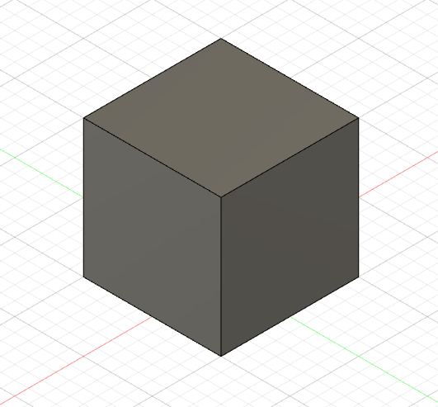
Axonometric projections
z
z
1:1
1:1
120°
120°
90°
90° + 45°
1:1
1:1
x
1:1
x
y
y
1:2
120°
Orthographic isometric projection
Oblique 'cabinet' projection

Slide 16
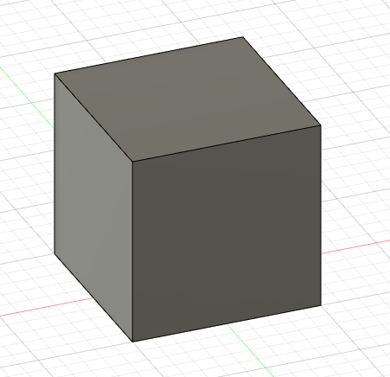
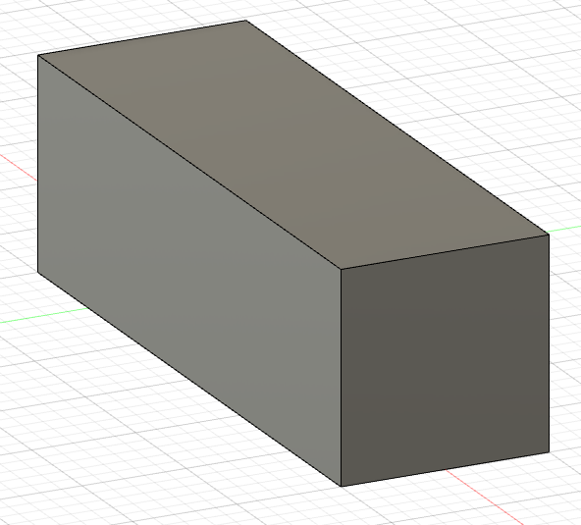
Parallel projections
B
B
A
A

Slide 17
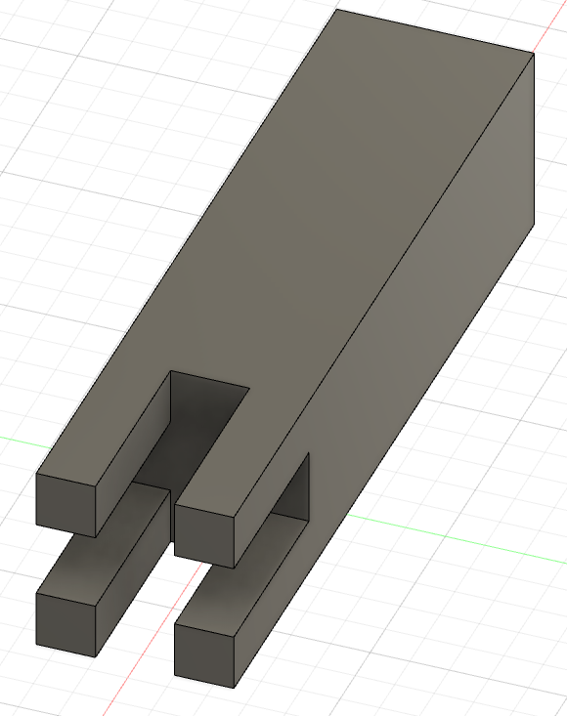
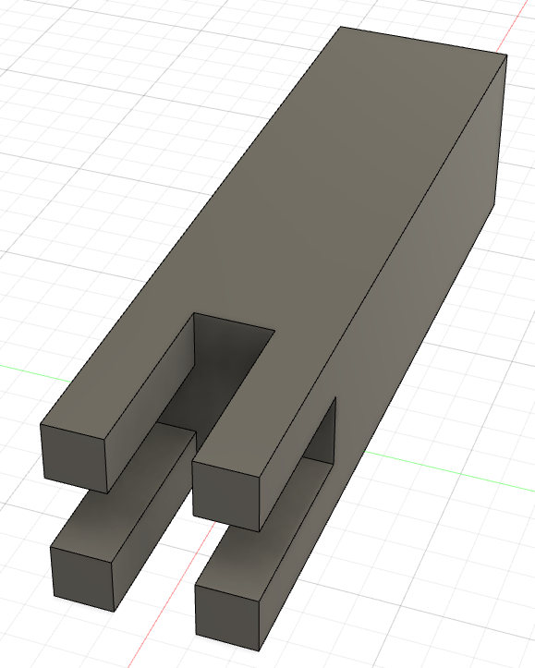
Parallel and perspective projections
B
B
A
A

Slide 18
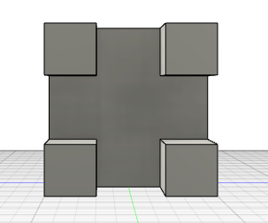
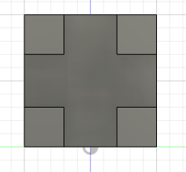
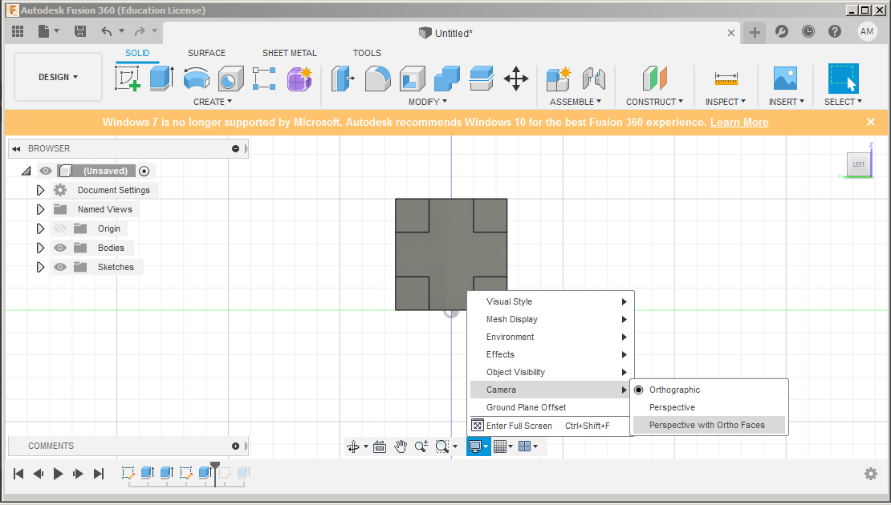
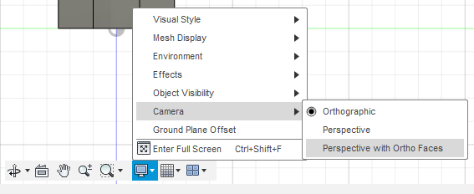
Parallel and perspective projections

Slide 19
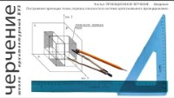

Slide 20
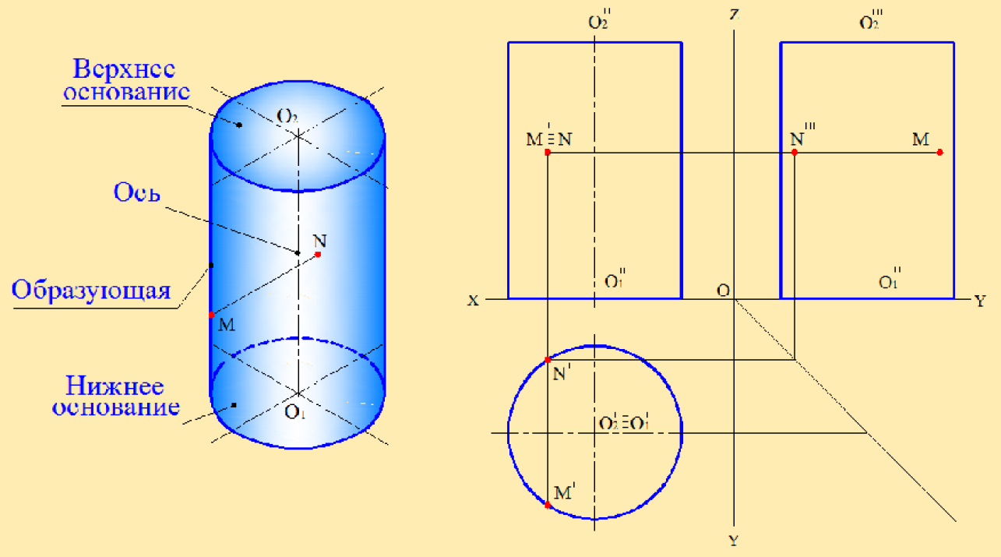
Orthographic Multiview projections
Top base
Axis
Generatrix
Bottom base

Slide 21
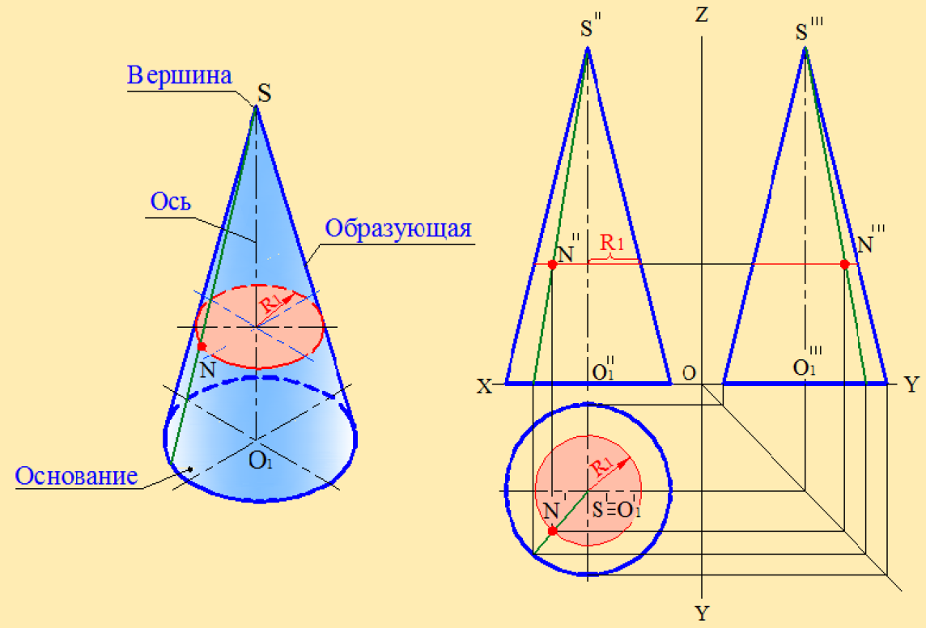
Orthographic Multiview projections
Apex
Axis
Generatrix
Base

Slide 22
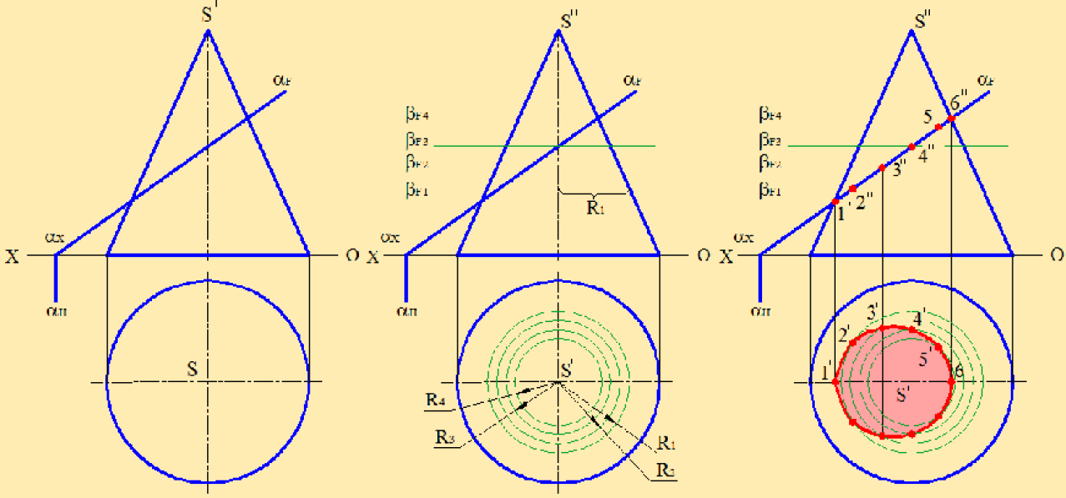
Orthographic Multiview projections

Slide 23
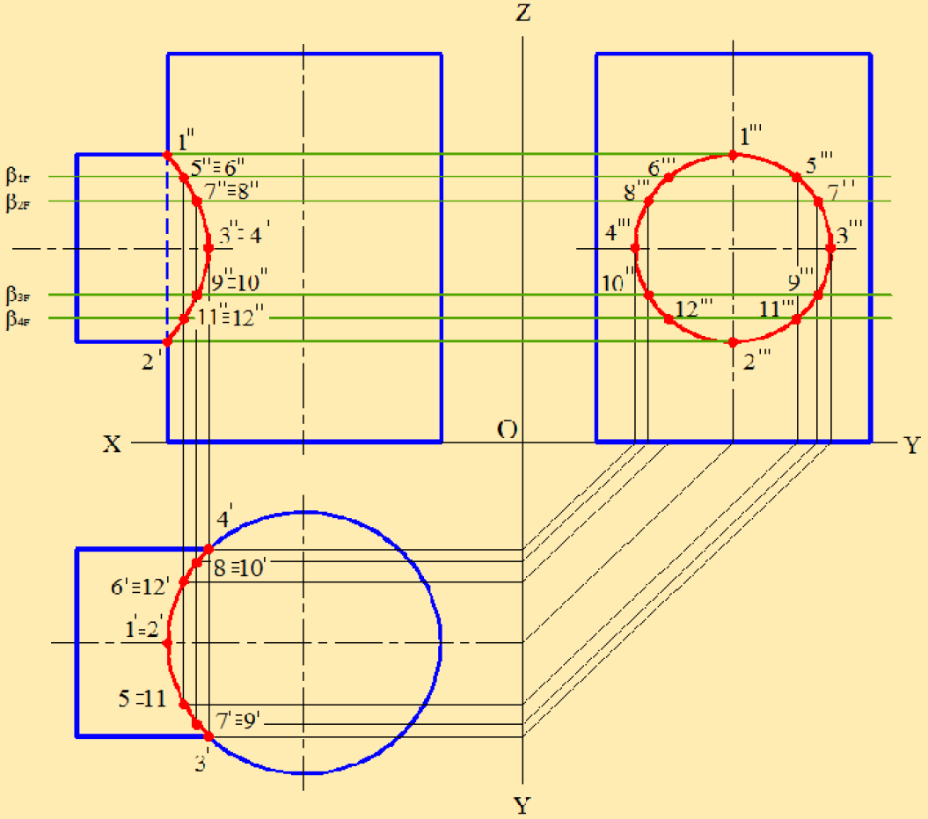
Orthographic Multiview projections

Slide 24
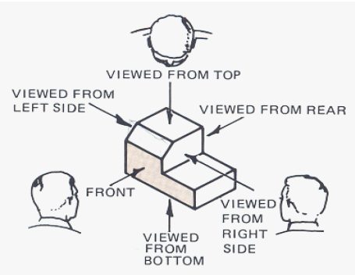
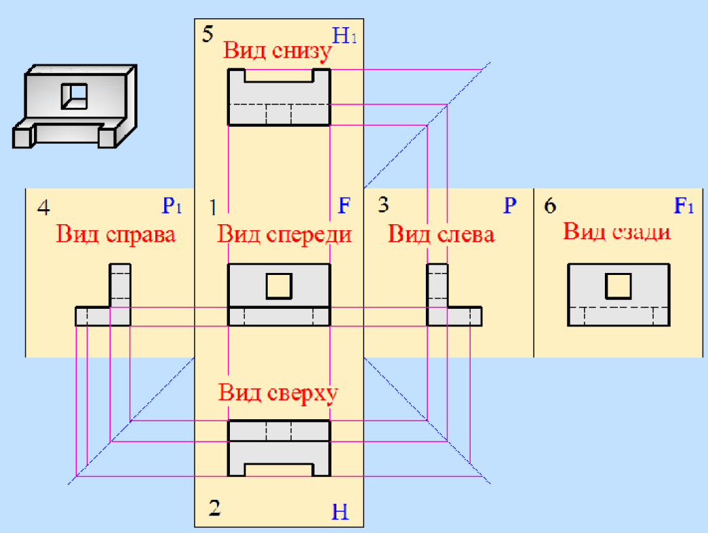
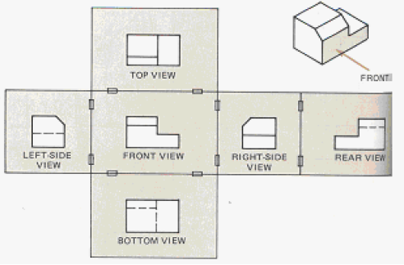
Orthographic Multiview projections
The difference between European and American standards
bottom view
right-side view
front view
left-side view
rear view
top view

Slide 25
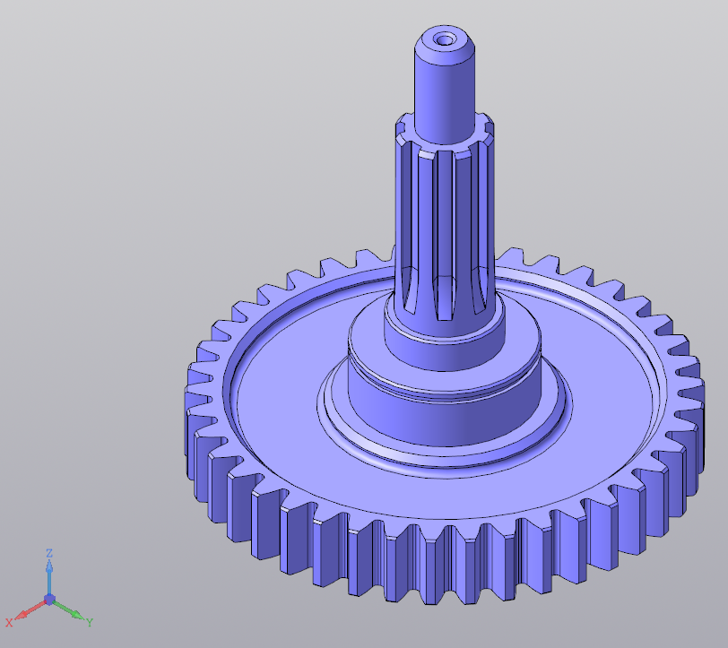
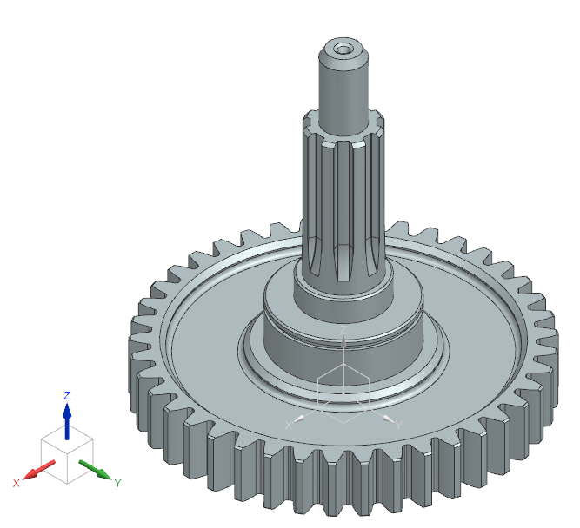
Orthographic multiview projections
Kompas 3D
Siemens NX

Slide 26
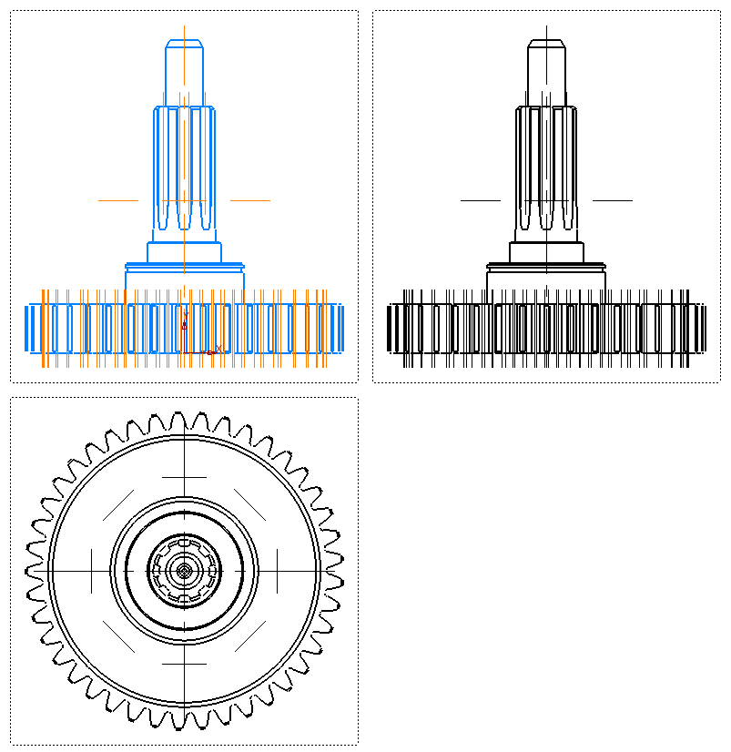
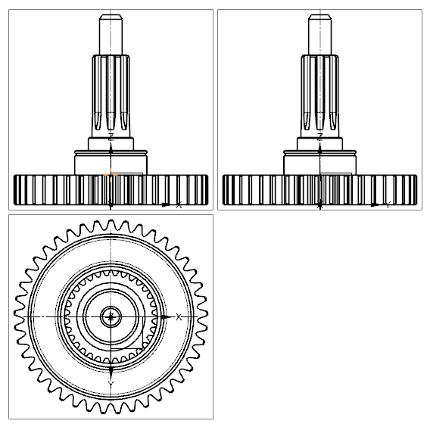
Orthographic multiview projections
Kompas 3D
(European system)
Siemens NX
(American system)

Slide 27
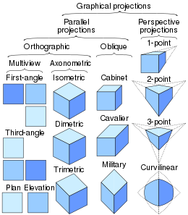
Classification of some 3D projections

Slide 28
Standards
A0
A1
Paper sizes
European size destination | Russian size destination | Sheet dimensions in mm
11 | A4 | 297x210
12 | A3 | 297x420
22 | A2 | 594x420
24 | A1 | 594x841
44 | A0 | 1189x841
A3
A2
Scales of reduction: 1:2, 1:2.5, 1:4, 1:5, 1:10, 1:15, 1:20, 1:25, 1:40, 1:50, 1:75, 1:100 etc.
Actual size: 1:1
Scales of increase: 2:1, 2.5:1, 4:1, 5:1, 10:1, 20:1, 40:1, 50:1, 100:1
A4
A5

Slide 29
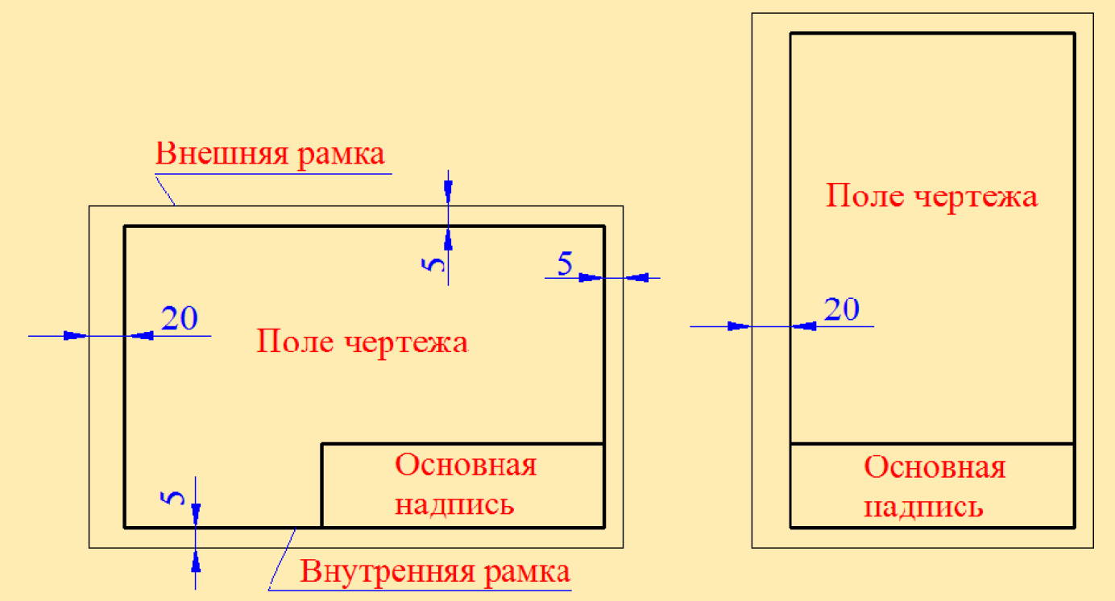
Standards
A4
Sheet border
Drawing field
A3
Drawing field
Title block
Title block
Drawing border

Slide 30
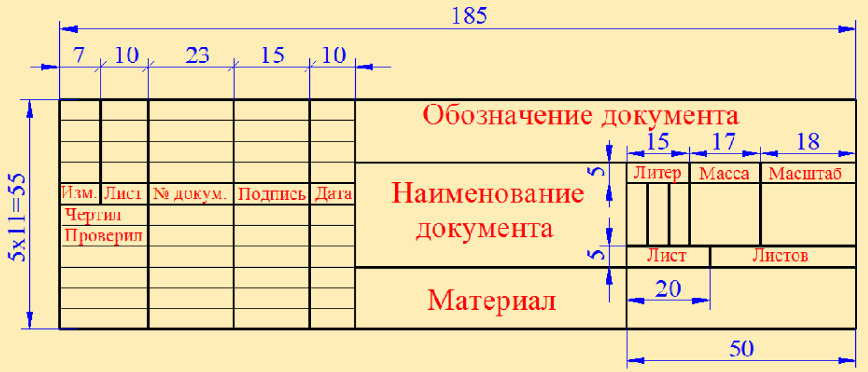
Standards

Slide 31
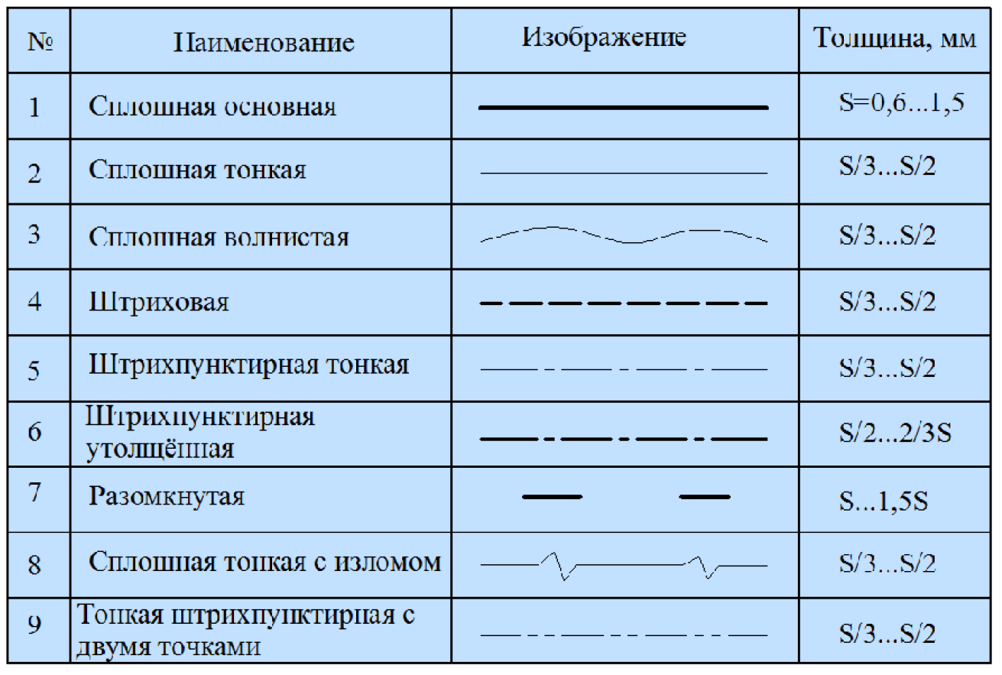
Standards
Name
Line
Thickness, mm
Visible line
Thin line (hatching of section, dimension, extension, arrows)
Freehand line
Hidden line
Dash-dotted line (thin)
Dash-dotted line (thick)
Line for section marking
Long-break line
Phantom line

Slide 32
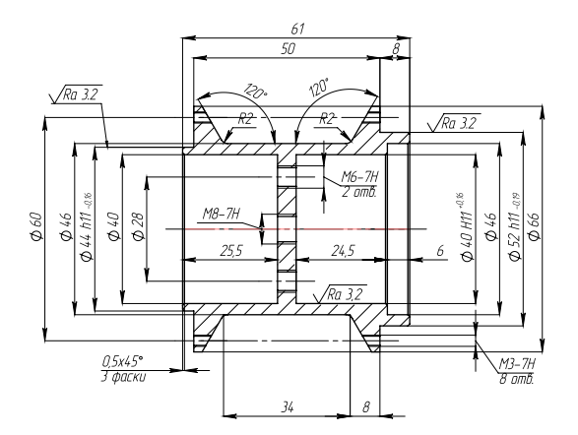
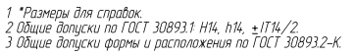

Slide 33
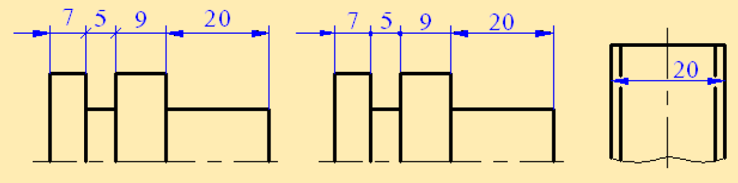
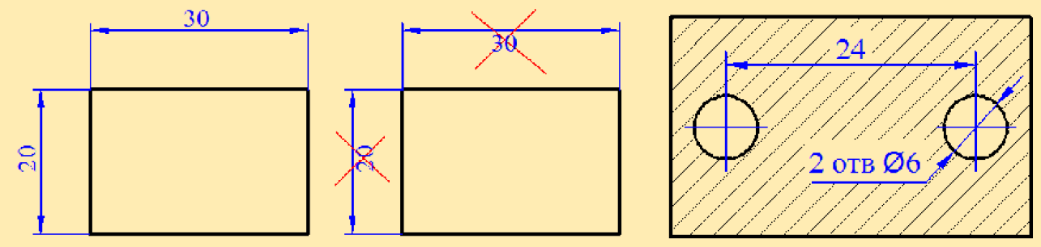
Standards

Slide 34
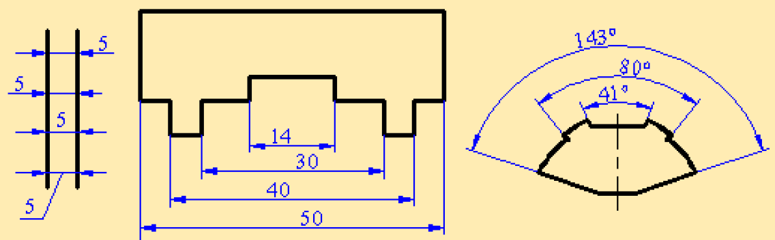
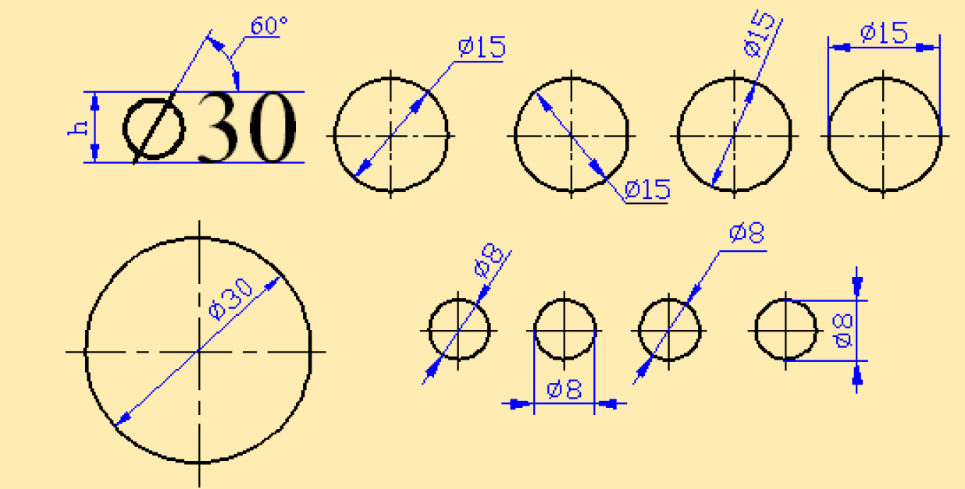
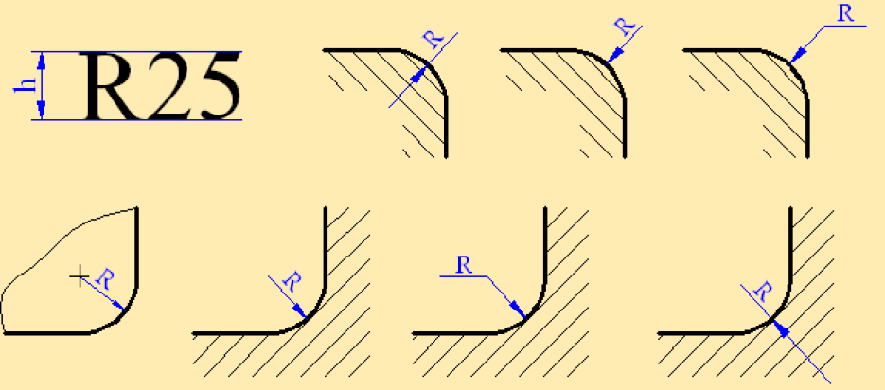
Standards

Slide 35
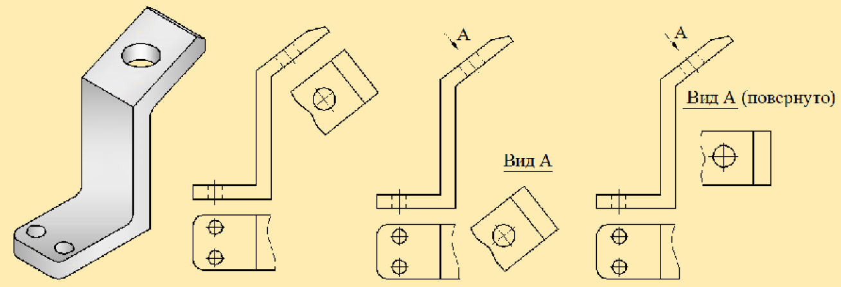
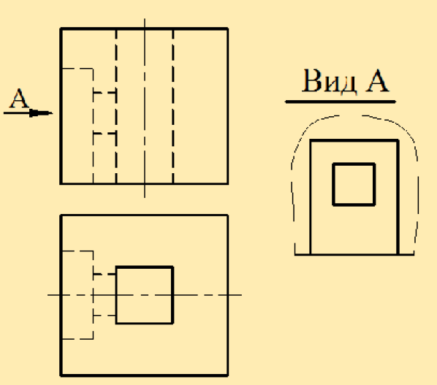
Standards

Slide 36
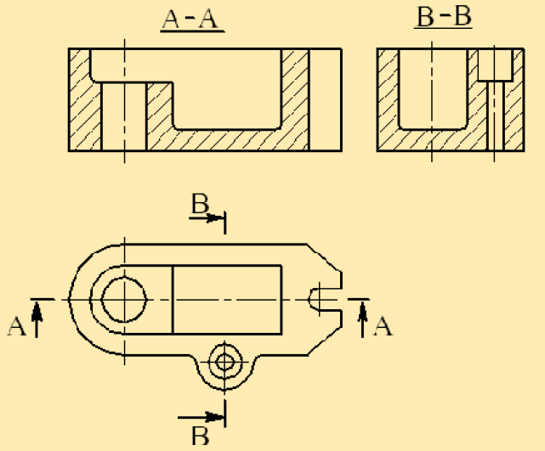
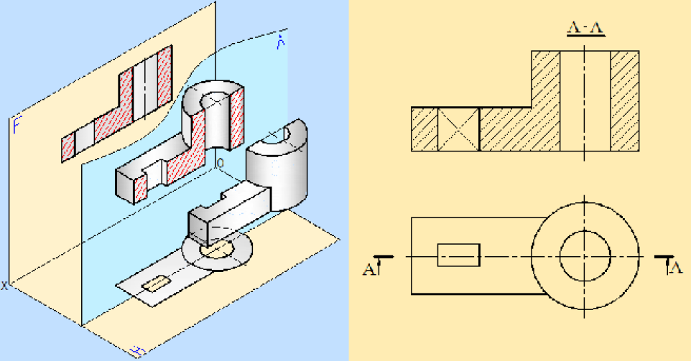
Standards

Slide 37
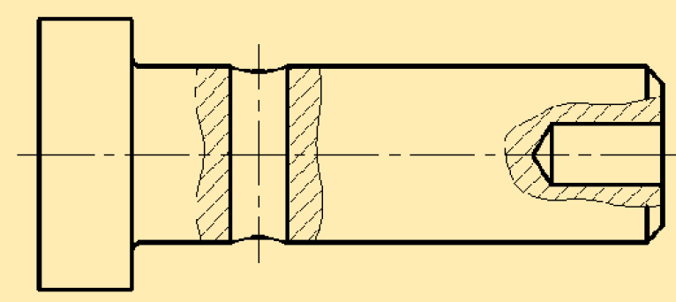
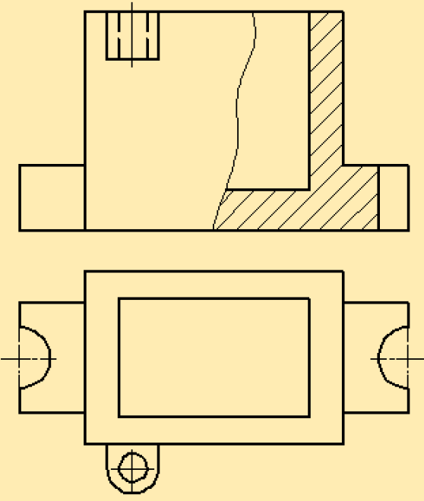
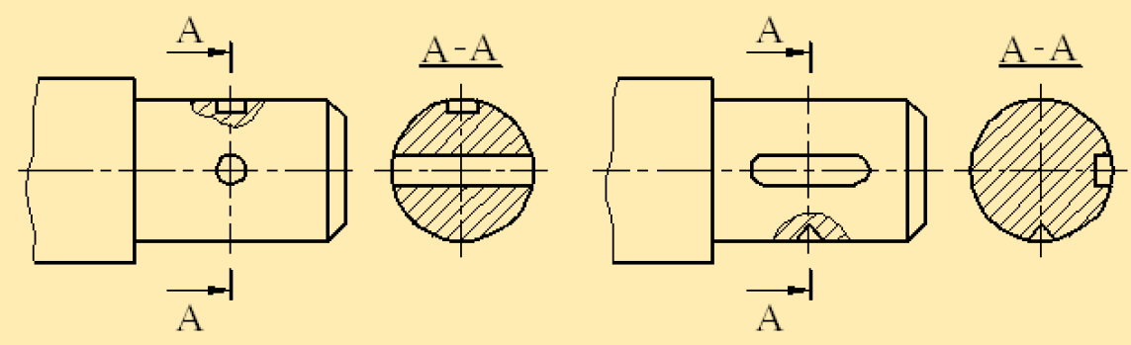
Standards

Slide 38
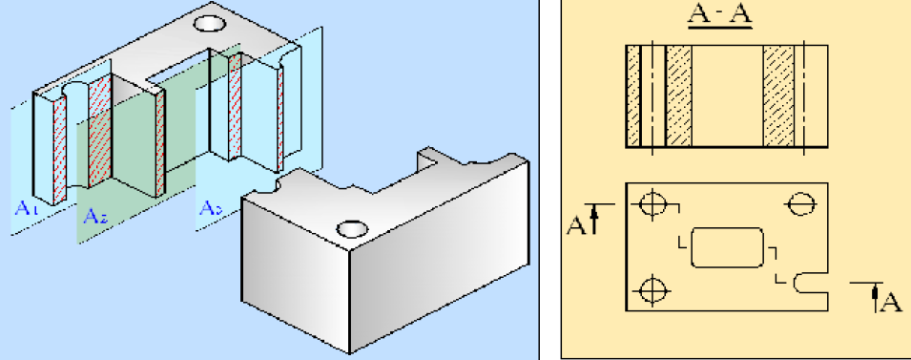
Standards

Slide 39
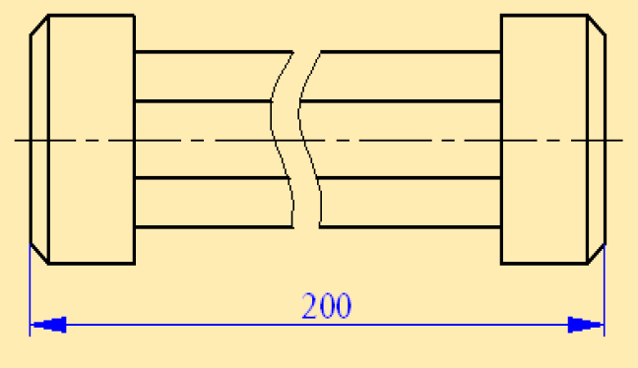
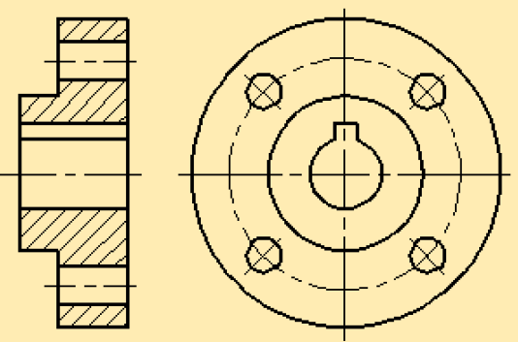
Standards

Slide 40
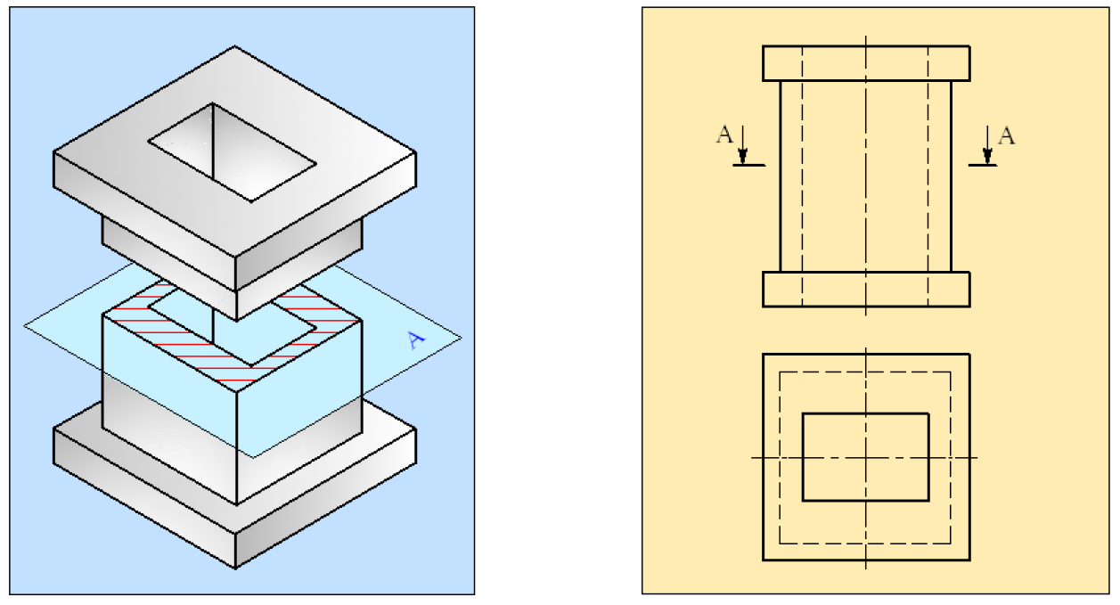
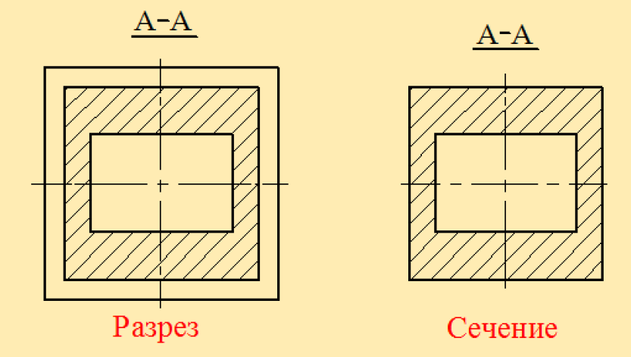
Standards

Slide 41
Reference material
Исследование «американской» и «европейской» систем проецирования
Методы проецирования (rus)
Инженерная графика (rus)

Slide 42
Deserve “A” grade!
– Oleg Bulichev

